Slide 1
Our Purpose Statement
As a community of women created in the image of God, called to discipleship in Jesus Christ, and empowered by the Holy Spirit, we commit ourselves to grow in faith, affirm our gifts, support one another in our callings, engage in ministry and action, and promote healing and wholeness in the church, the society, and the world.
Notes:
Women of the ELCA Purpose Statement
Leave this slide up before you begin your presentation. Lead the group in reciting the purpose statement.

Slide 2
Notes:
Introduce yourself and explain why you are sharing this PowerPoint.

Slide 3
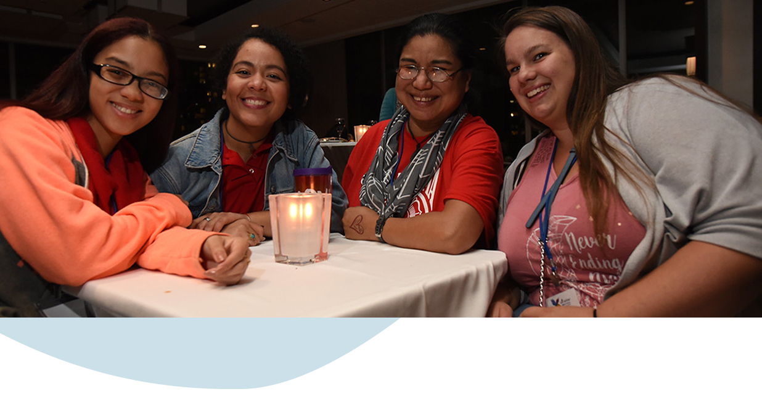
Who are we?
A community of women in thousands of congregations across
the U.S. and Caribbean.
Notes:
When people hear “Women of the ELCA” many people think of two things: Bible study and quilting. While that’s a part of what Women of the ELCA is all about, Women of the ELCA is a whole lot more. We are a community of women … women of all ages, of many races, with different educations and experiences. We are urban, suburban, rural and small town. Women in this organization come together in community – whether real or virtual – for study, fellowship, advocacy, and service. We have traditional circles engaged in Bible studies – some have been gathering monthly for more than 40 or 50 years. But we also have young women coming together at a local coffeehouse using our e-zine Café for their study.

Slide 4
“Women of the ELCA has brought women into my life that I would never have known. They inspire me and have strengthened my faith.” —Merlene Swenson Brockway

Slide 5
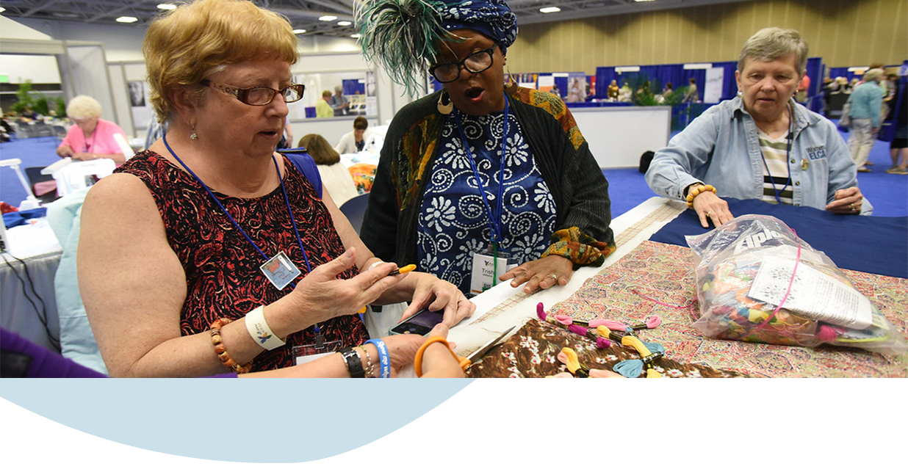
Why do we gather?
To grow in faith and live out that faith through ministry and action.
Notes:
Why do we gather?
In Women of the ELCA, you will find:
Support on your faith journey
Opportunities to serve and make a difference in your community and around the world
A community that prays together
Bible study and theological discussions
Faith mentors and lifelong friendships

Slide 6
“WELCA helped me to recognize my call to ministry. Over 20 years in ministry; more than 15 years ordained.” —Victoria L. Hamilton
What’s the best thing about
Women of the ELCA?
Friendship, fellowship and support

Slide 7
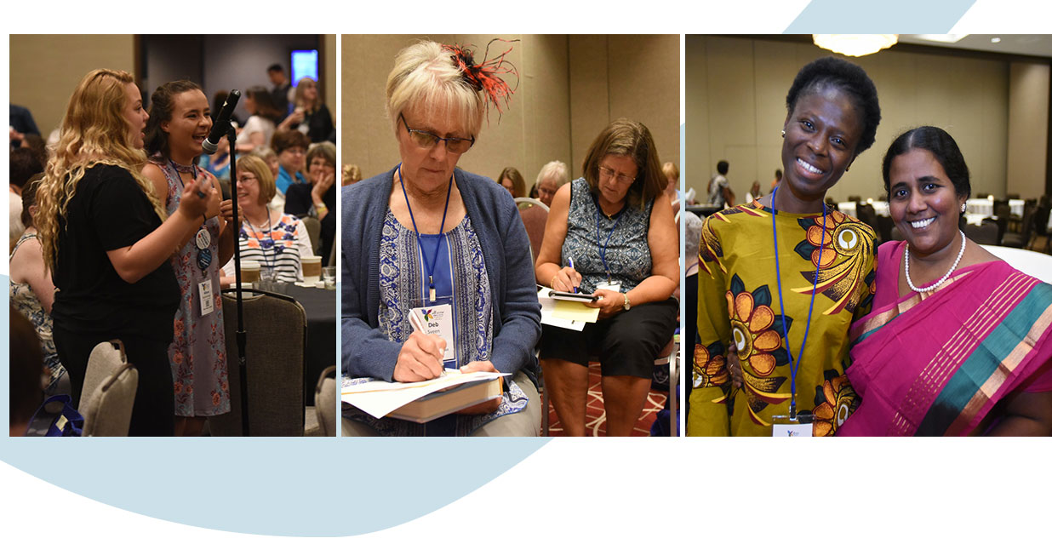
What’s the best thing about
Women of the ELCA?
Friendship, fellowship and support
Notes:
What’s the best thing about Women of the ELCA?
Friendship, fellowship and support
Women consistently say how much they value the friendship, fellowship and support they experience by being part of a community of women of faith. Together we grow in faith and engage in ministry and action, helping in our congregations, communities and throughout the world.

Slide 8
“With WELCA I get to learn and grow with other women! There’s something about a room full of women sharing their faith and helping each other grow that is pretty amazing.” —Caroline Guy
What’s the best thing about
Women of the ELCA?
Friendship, fellowship and support

Slide 9
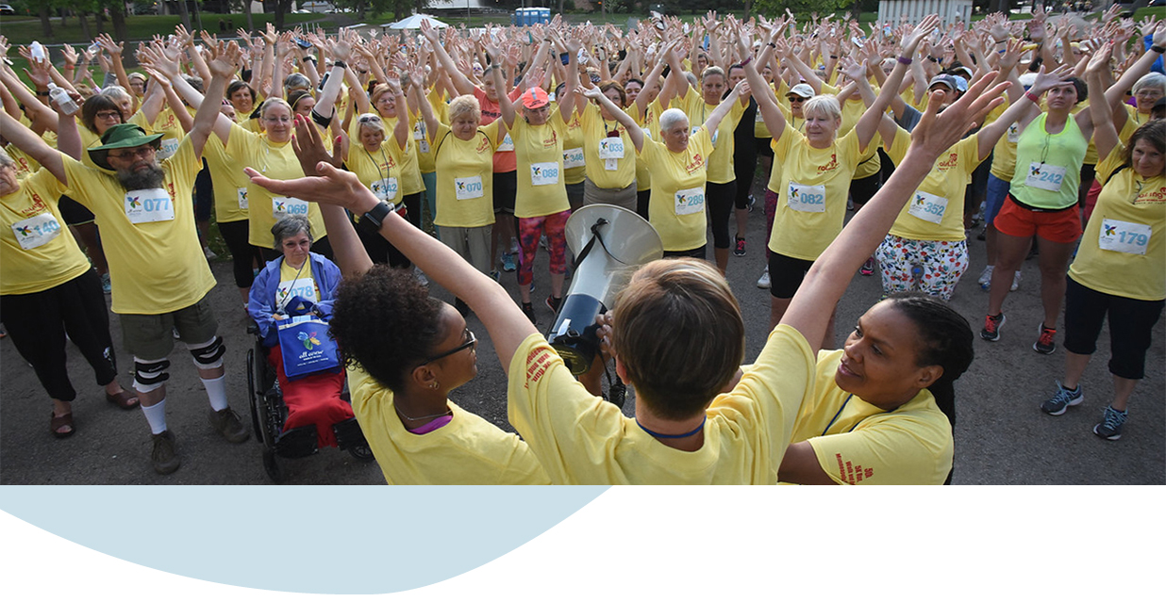
We’re raising up healthy women and girls
When we commit to caring for ourselves, we can fully commit to
our purpose and mission.
Notes:
We’re raising up healthy women and girls
We can commit to God’s command to make disciples in the world and stand ready to serve others. Healthy women can produce healthy families, churches, and communities, and can develop healthy, more just, and more holistic societies. Learn more about our health initiative at womenoftheelca.org.

Slide 10
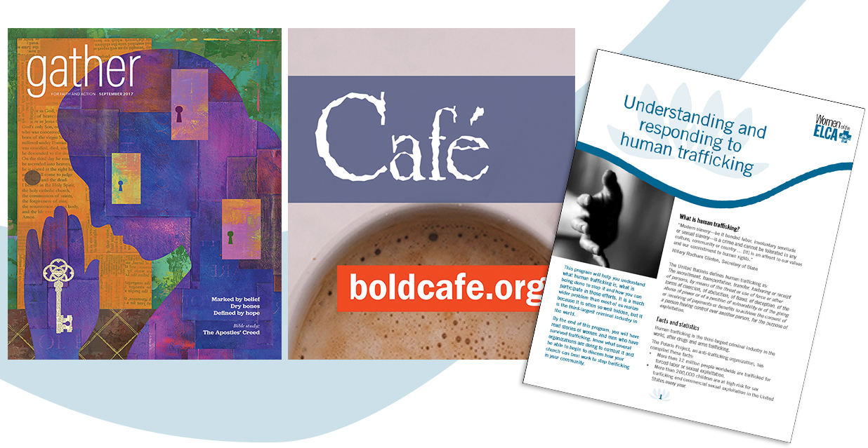
Stay connected
Whether you participate a lot or a little in Women of the ELCA, you can stay
connected in many ways.
Gather
Café (boldcafe.org)
Bold Connections
Daily Grace
Facebook
Twitter
Pinterest
Instagram
Notes:
Stay connected Gather, the magazine of Women of the ELCA, offers a mix of articles, theological reflections, devotions and stories of comfort and challenge that help readers grow in faith and engage in ministry and action. Find it at gathermagazine.org.
Café is an award-winning, web-based magazine (boldcafe.org) for young adult women who are interested in how faith relates to issues women face today.
Bold Connections is a free monthly e-newsletter featuring all the latest news.
Daily Grace is a smartphone app offering daily devotions, reflections, prayers and more.
Facebook is an online community you can be a part of even if you are not in a local group.
Twitter is a way to communicate in 140 characters or fewer.
Pinterest is an electronic pin board that allows users upload, save, sort, manage and view images.
Instagram is a fun way to share your life in photos.

Slide 11
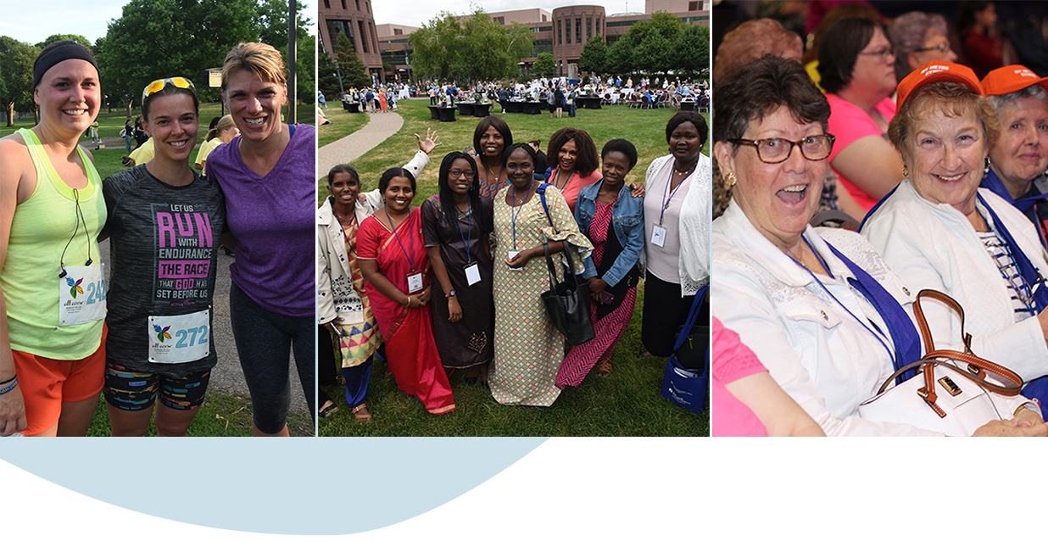
We support women of all ages
The churchwide organization supports women of all ages in
congregations across the U.S. and the Caribbean who gather in
community to grow in faith and serve God.
Notes:
We support women of all ages
Women of the ELCA supports women as they discern God’s call in their lives and discover their spiritual gifts.
We do that through workshops, retreats, resources, scholarships and global education.
We also provide anti-racism training, address harassment and related violence, domestic violence, bullying, immigration issues and human trafficking.
We offer grants to nonprofit organizations, both domestic and international, that support healing and wholeness for women of all ages.

Slide 12
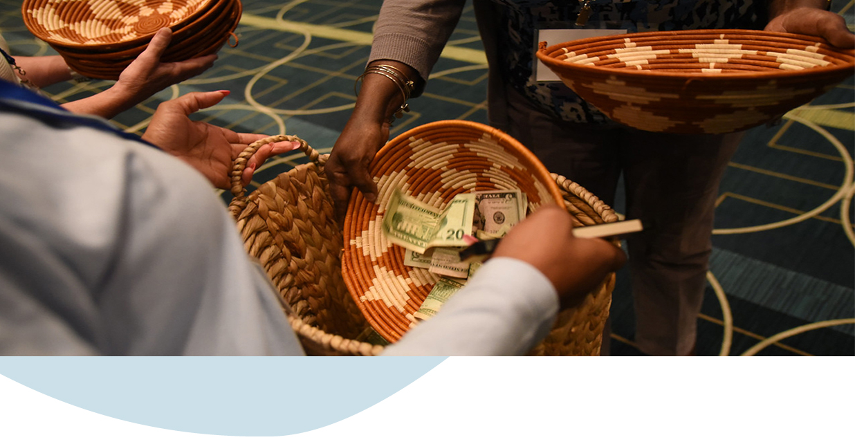
And we appreciate your support
Experience the joy of giving to Women of the ELCA ministries
Katie’s Fund
Raising Up Healthy Women and Girls
Scholarships
Faithful Friends
Thankofferings
Notes:
And we appreciate your support For Women of the ELCA, stewardship is about the bigger picture. Thousands of women in thousands of congregations give boldly to support ministries that educate, inspire, and mobilize women around the world. Learn how your gifts can support Women of the ELCA ministries today, through Thankofferings, Katie’s Fund, and more at womenoftheelca.org.

Slide 13
Womenoftheelca.org
Facebook.com/WomenoftheELCA
Twitter.com/WomenoftheELCA
Pinterest.com/WomenoftheELCA
Instagram.com/WomenoftheELCA

